Slide 1
Hemocytometry

Slide 2
Hemocytometry
It is the procedure of counting the number of cells in a sample of blood; RBC, WBC, & the platelets being counted separately.
It is assumed that the cells are homogenously mixed (suspended) in the plasma in all regions of the body.

Slide 3
Principle
Since the number of blood cells is very high, it is difficult to count them even under the microscope.
This difficulty is partly overcome by diluting the blood to a known degree with suitable diluting fluids and then counting them.

Slide 4
Principle
The sample of blood is diluted in a special pipette and is then placed in a capillary space of known capacity (volume) between a specially ruled glass slide (counting chamber) and a coverslip.

Slide 5
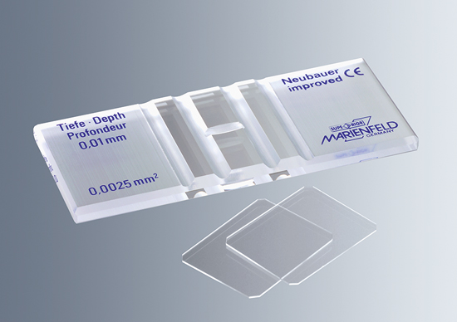

Slide 6
Principle
The cells spread out in a single layer which makes their counting easy.
Knowing the dilution employed, the number of cells in undiluted blood can then easily be calculated.

Slide 7
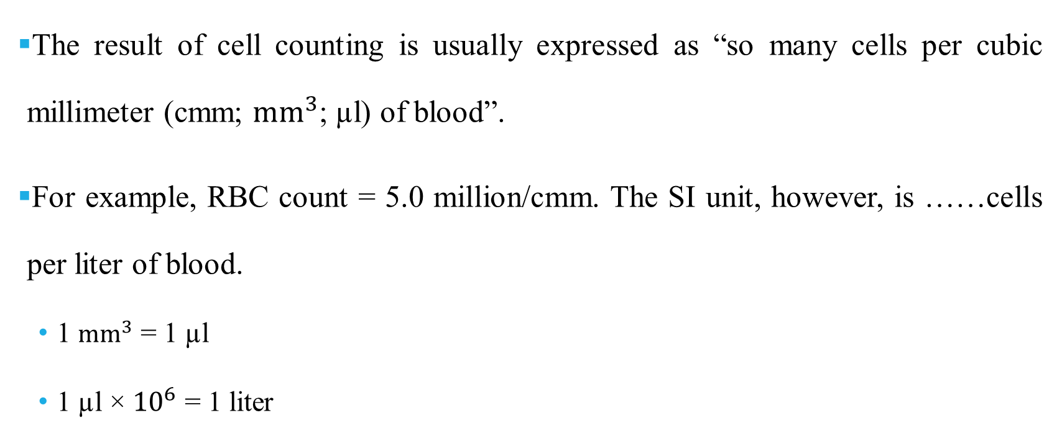
Units for reporting
The result of cell counting is usually expressed as “so many cells per cubic millimeter (cmm; ${mm}^{3}$; µl) of blood”.
For example, RBC count = 5.0 million/cmm. The SI unit, however, is ……cells per liter of blood.
  1 ${mm}^{3}$ = 1 µl
  1 µl × ${10}^{6}$ = 1 liter
Notes:
L=1000 ml
ml=1000 µl
L= 1000,000 µl=${10}^{6}$ µl

Slide 8
Hemocytometer
The hemocytometer set consists of the following:
  The diluting pipettes
  The counting chamber
  Coverslips
  RBC and WBC diluting fluids

Slide 9
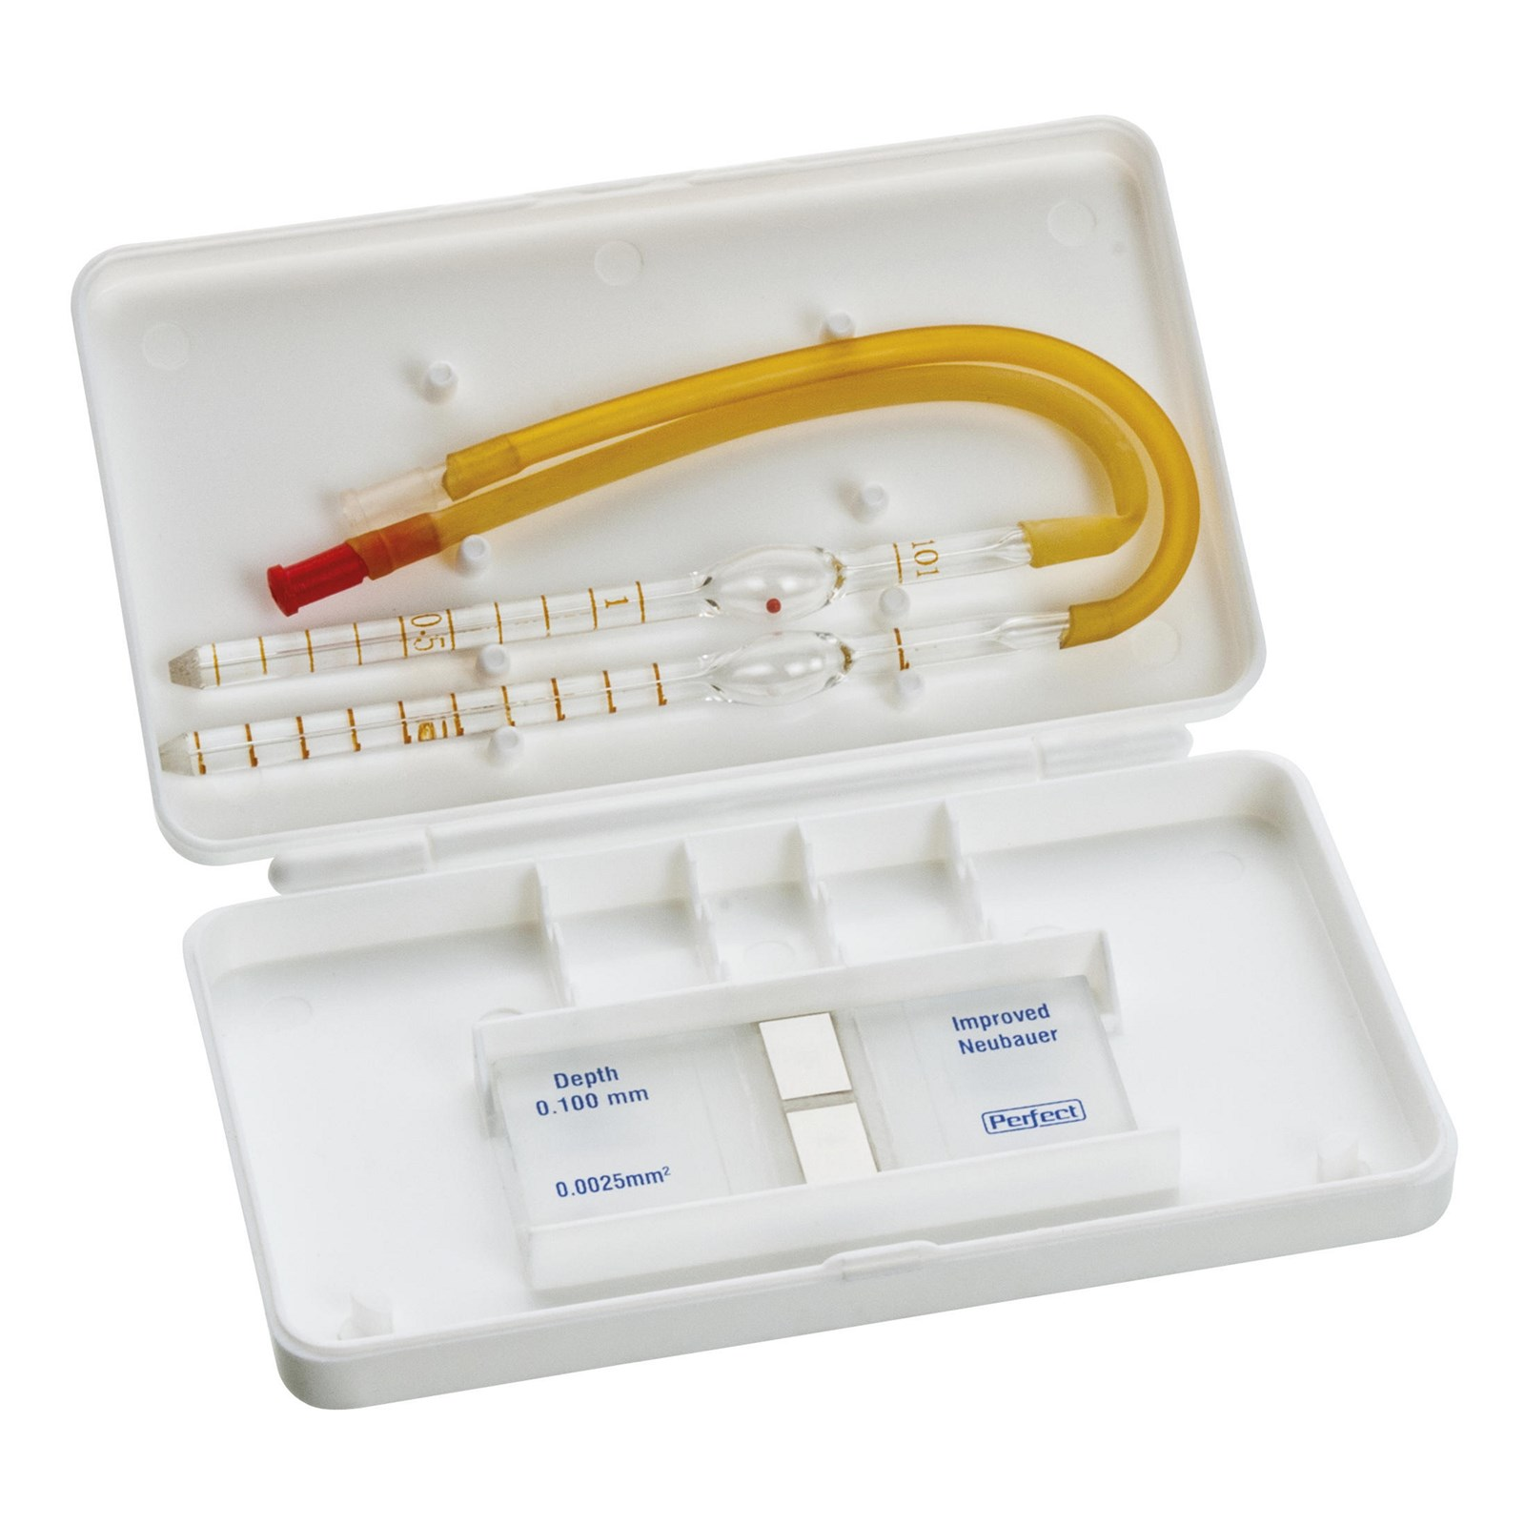

Slide 10
Diluting pipettes
The diluting pipettes:
  RBCs glass capillary pipette (with a bulb, red bead).
  WBCs glass capillary pipette (with a bulb, white bead).

Slide 11
Parts of diluting pipette
The stem
  The long narrow stem has a capillary bore and a conical tip.
  It is divided into 10 equal parts (graduations) but has only two numbers etched on it (0.5 in the middle of the stem, and 1.0 at the junction of stem and the bulb).
  The pipette, has a glossy white surface behind the graduations to facilitate their reading.

Slide 12
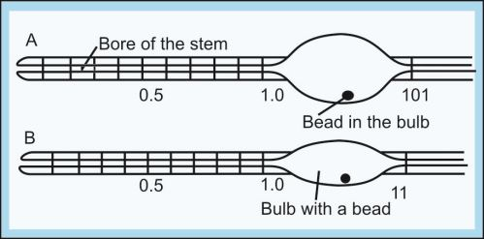
Parts of diluting pipette

Slide 13
Parts of diluting pipette
The bulb
  The stem widens into a bulb which contains a free-rolling bead (red in the RBC pipette, & white in the WBC pipette), The bead helps in mixing the blood and the diluent.
Rubber tube & mouthpiece
  The bulb narrows again into a short stem to which a long, narrow, soft-rubber tube bearing a mouthpiece is attached.
  Just beyond the bulb, the number 101 is etched on the RBC, and 11 on the WBC pipettes.

Slide 14
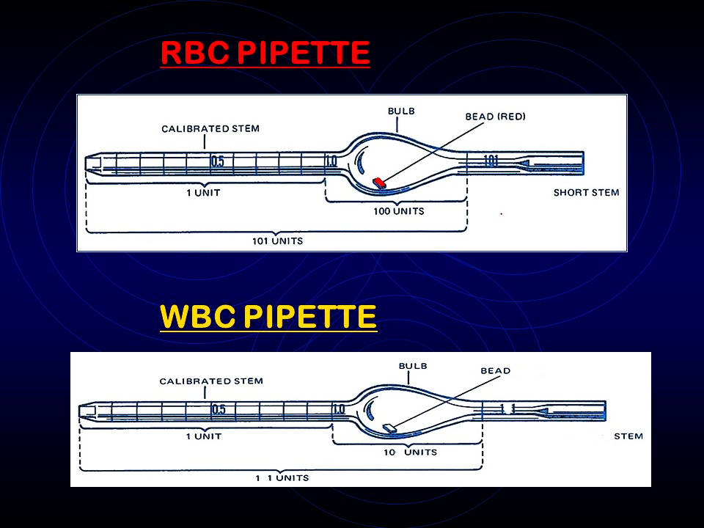
RBC pipette
WBC pipette

Slide 15
Principle underlying the use of diluting pipettes
The numbers marked on the pipettes do not indicate definite volumes in cubic millimeters (or µl).
These figures only indicate relative volumes (parts)/or relative volumes in relation to each other.
Notes:
These figures only indicate relative volumes (parts)/or relative volumes in relation to each other;
Half volume (from tip to mark 0.5).
One volume (from the tip to mark 1.0) in both pipettes.
Eleven volumes (from tip to mark 11 above the bulb in WBC pipette).
Hundred one volumes (from tip to mark 101 in RBC pipette).

Slide 16
Differences between the pipettes
RBC pipette | WBC pipette
Calibrations are 0.5 & 1.0 below the bulb and 101 above the bulb | Calibrations are 0.5 & 1.0 below the bulb and 11 above the bulb
The bore is smaller | The bore is larger
Bulb is large | Bulb is small
The volume of the bulb is 100 time the volume of the stem | The volume of the bulb is 10 time the volume of the stem
The dilution is 1 in 200 | The dilution is 1 in 20

Slide 17
Steps in hemocytometry
Keeping all the equipment ready
Getting a sample of blood
Pipetting, (filling the pipette with blood and diluting it)
Charging the chamber, (filling the counting chamber with diluted blood)
Counting the cells and reporting the results

Slide 18
Filling the pipette
Place a drop of anticoagulated blood on a glass slid, or get a finger-prick under aseptic conditions.
Holding the mouthpiece of the pipette between your lips and keeping the pipette (with its graduations facing you) at an angle of about 40° to the horizontal, place its tip within the edge of the drop. Gently suck on the mouthpiece and draw blood until it is just above the mark 0.5.

Slide 19
Filling the pipette
Remove the pipette from the blood drop and clean its outer surface with a cotton swab by wiping it toward the tip.
Keeping the pipette horizontal all the time, bring the blood in the stem to the exact mark 0.5 by wiping the tip on a paper a couple of times till the blood recedes to the exact mark.

Slide 20
Filling the pipette
Holding the pipette nearly vertical, immerse its tip in the diluting fluid taken in a watch glass, and suck the diluent to the mark of (11 WBC) or (101 RBC).
Mixing the blood with the diluting fluid
  Remove the rubber tube & hold the short stem above the bulb between your thumb and first two fingers, and pressing the tip of the pipette against the palm of the other hand, rotate it to for 3–4 minutes so that the blood and diluent get thoroughly mixed.

Slide 21
The counting (Neubauer chamber)
It is a single, solid, heavy glass slide.
The counting region consists of two square shaped ruled areas.
There are depressions on either side or in between the areas on which the squares are marked thus giving an “H” shape.

Slide 23
The counting (Neubauer chamber)
The ruled area is 3mm² divided into 9 large squares, separated from one another by triple lines and each with a 1 mm² area.
The ruled area is 0.1 mm lower than the rest of the chamber. So there is a gap of 0.1 mm between the cover slip and the ruled area.

Slide 24
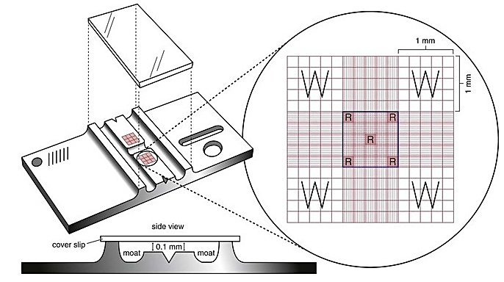

Slide 25
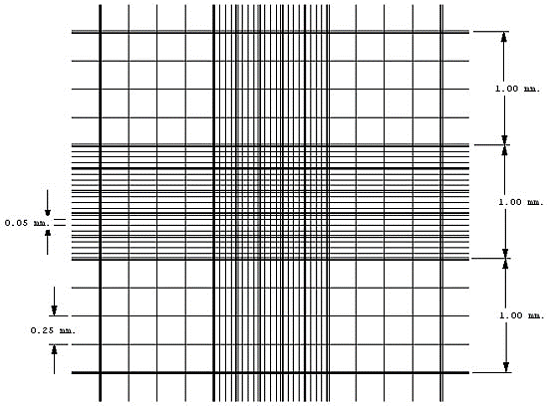

Slide 26
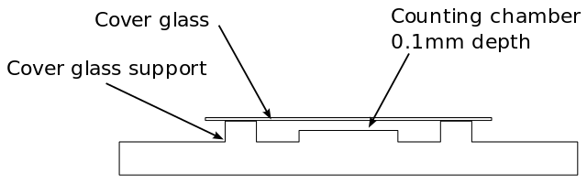
The counting chamber: side view

Slide 27
Focusing the counting grid
Examine the counting grid under low and high magnifications.
With low magnification (10X), one large square is visible in one field;
  A group of 16 medium squares (for WBC counting).
  A groups of 25 medium squares (for RBC counting).

Slide 28
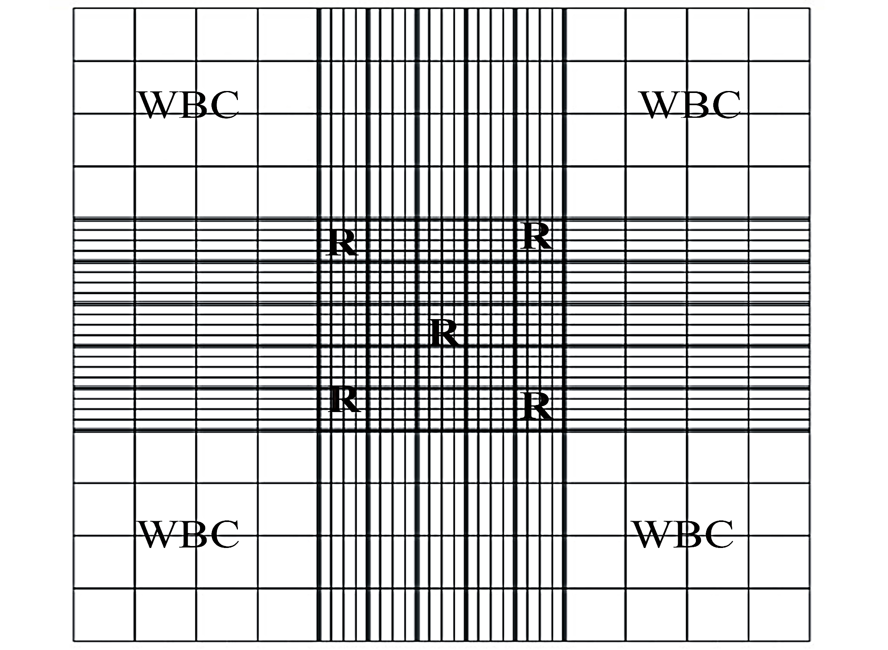

Slide 29
Charging the chamber
Place a coverslip on the chamber.
Keeping your finger over the top of the pipette and releasing it in a controlled manner, allow the first 2 drops to drain by gravity. This fluid contains cell-free diluting fluid in the stem which has not taken any part in the dilution of blood.

Slide 30
Charging the chamber
Hold the pipette at an appropriate angle and allow a drop of diluted blood to form at its tip. Then quickly place the tip of the pipette on the floor piece in gentle contact with the edge of the coverslip.

Slide 31
Charging the chamber
As the surface of the drop touches the coverslip, the fluid will run under it and form a uniform film.
Lift the pipette as soon as the floor piece is covered with diluted blood.

Slide 32
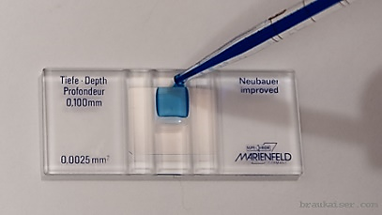
Charging the chamber

Slide 33
Charging the chamber
Ideally charged chamber: if it is completely filled with diluted blood.
Over-charged chamber: If any blood flows into the trenches.
Under-charged chamber: If the fluid is insufficient to cover the floor piece, or if there are air bubbles.
Notes:
The chamber should be charged at one go and not in parts. For this, one needs a drop of proper size. Try to achieve an ideally-charged chamber.

Slide 34
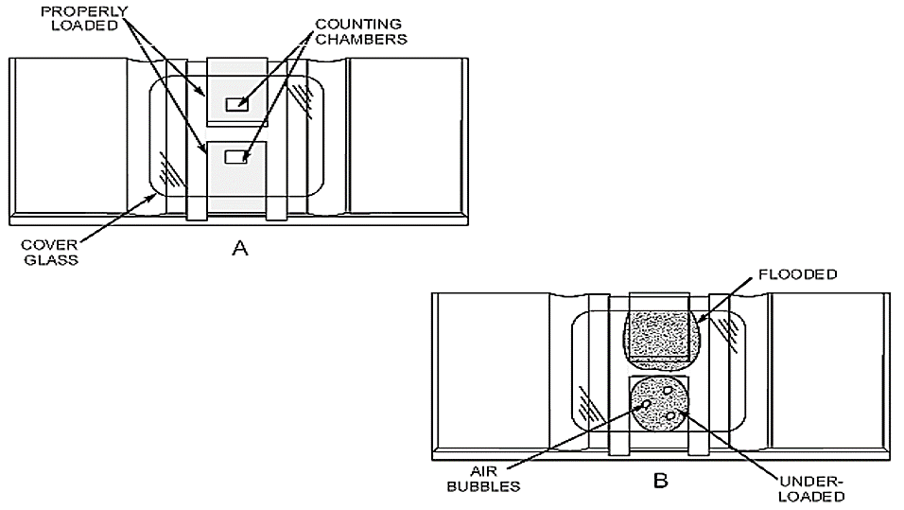

Slide 35
Sources of error in cell counting
Three important sources of error;
  Pipette error
  Chamber error
  Field error
These errors can produce a variation of as much as 10–15%, or even more in the hands of a student.

Slide 36
PRECAUTIONS
                The pipette should be clean and dry and the bead should roll freely.
The pipette should not be lifted out of the blood drop while filling it with blood, otherwise air will enter it.

Slide 37
PRECAUTIONS
The drawing up of diluent, after blood has been taken in the stem, should not be delayed, otherwise it will clot in it.
The pipette should be cleaned soon after the experiment is over.
Do not touch blood other than your own.

